Slide 1


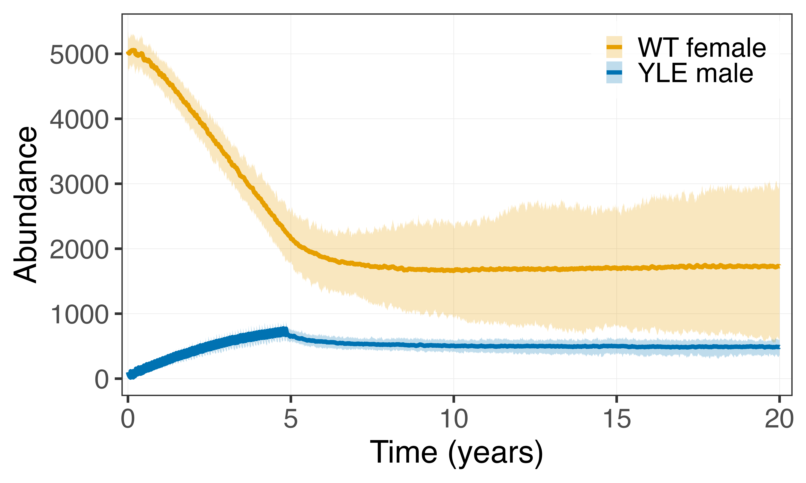




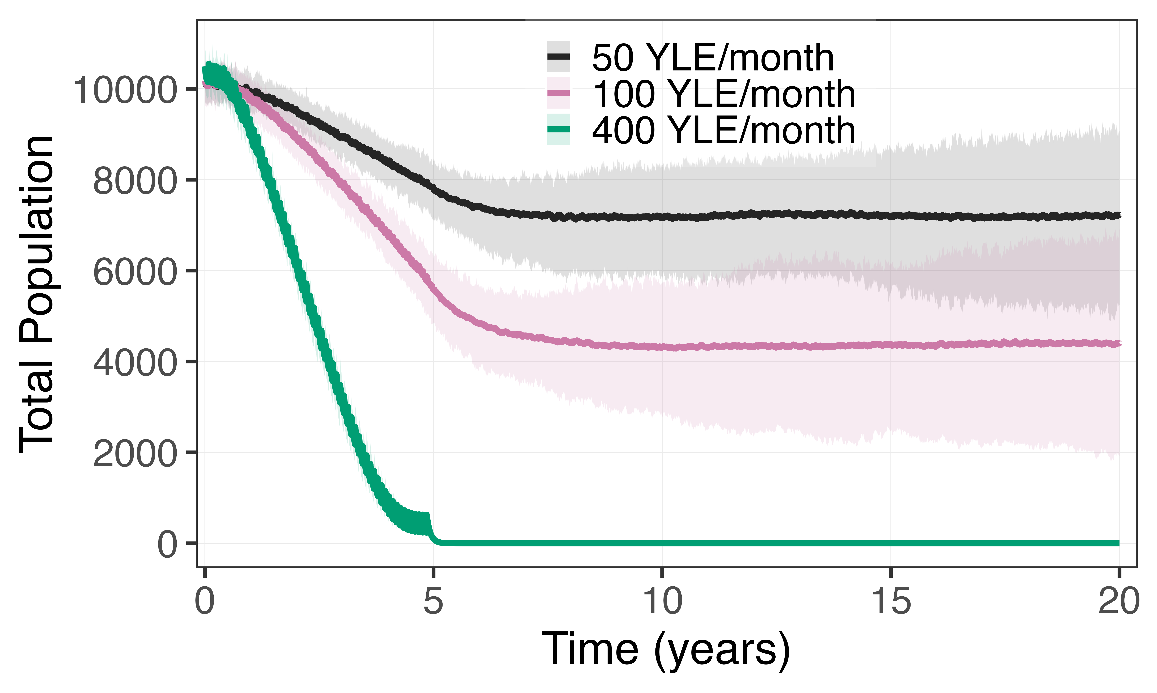

a
b
YLE Male
WT Female
Edited Female (Non-viable/sterile)
c
Y-Linked Editor
Female specific
Dominant mutation

Slide 2
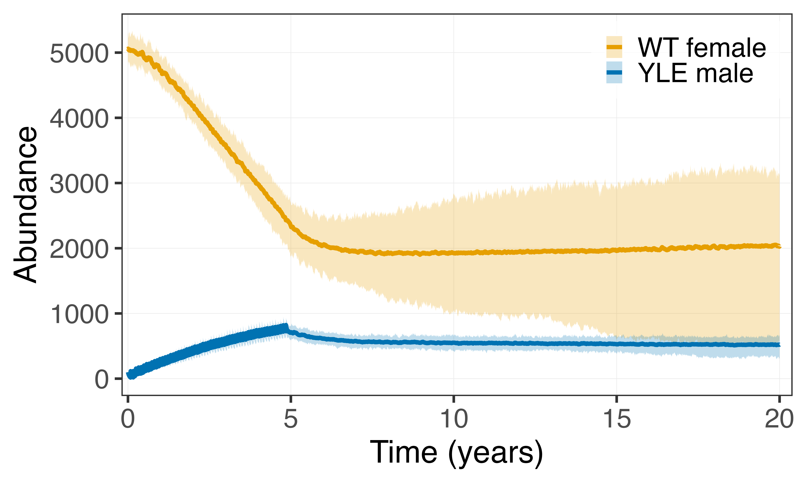
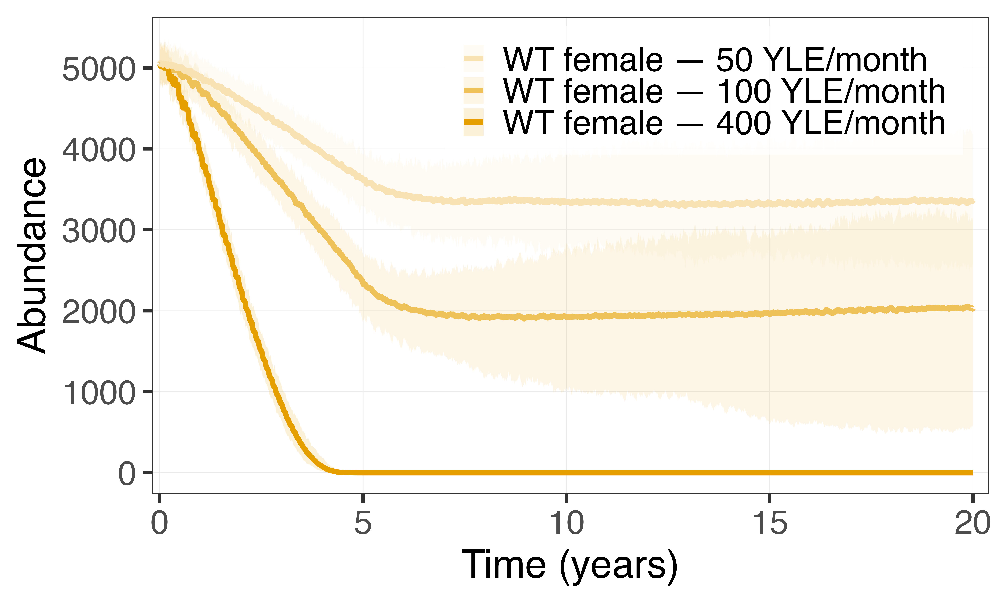
a
b
YLE Male
WT Female
Edited Female (Non-viable/sterile)
c
Y-Linked Editor
Female specific
Dominant mutation

Slide 3


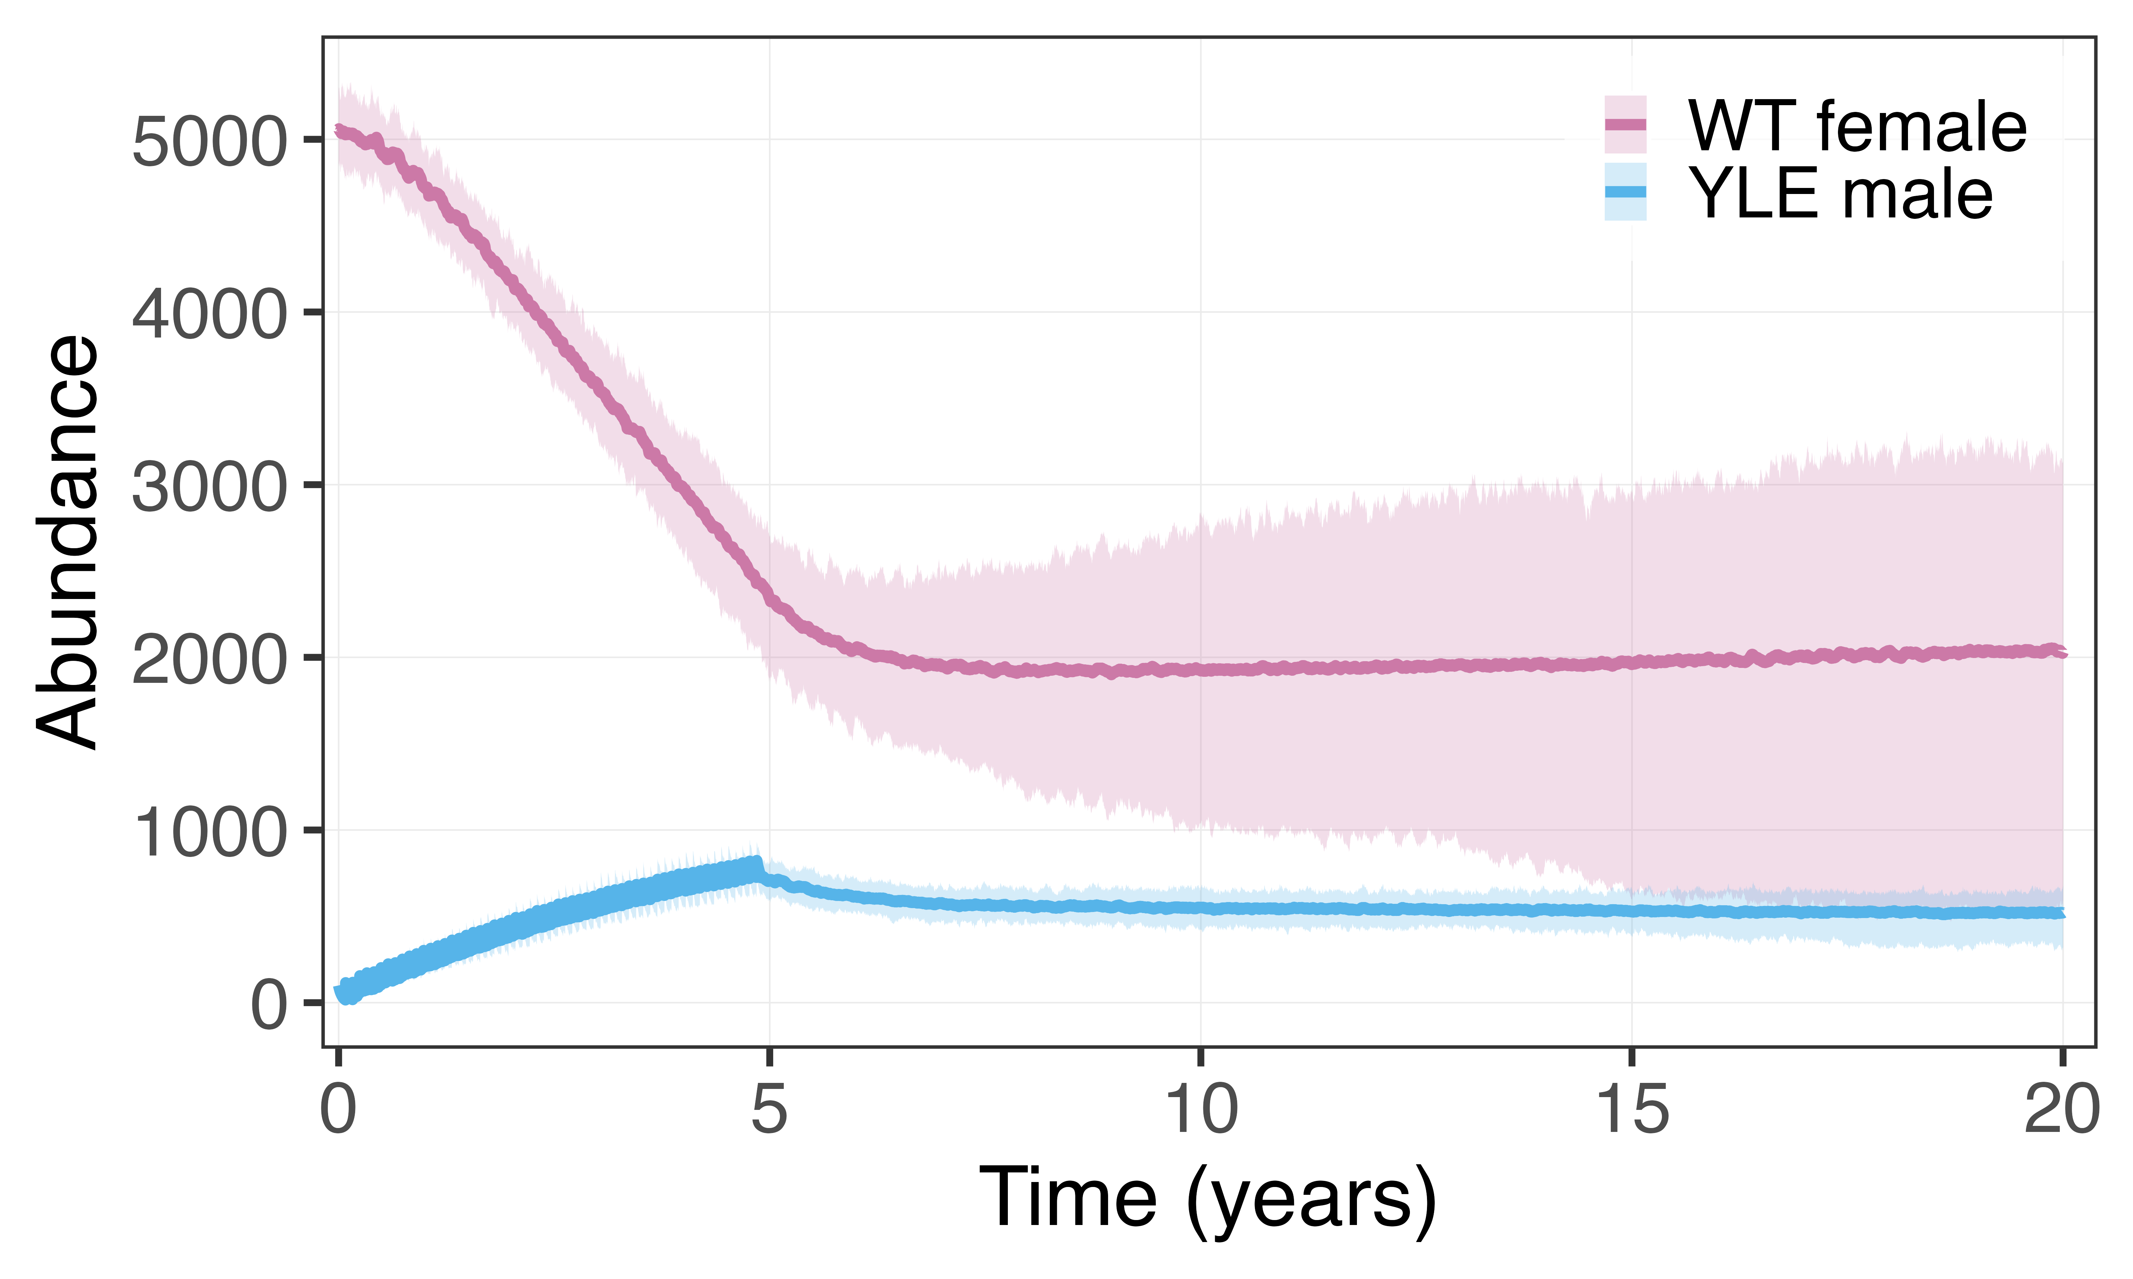

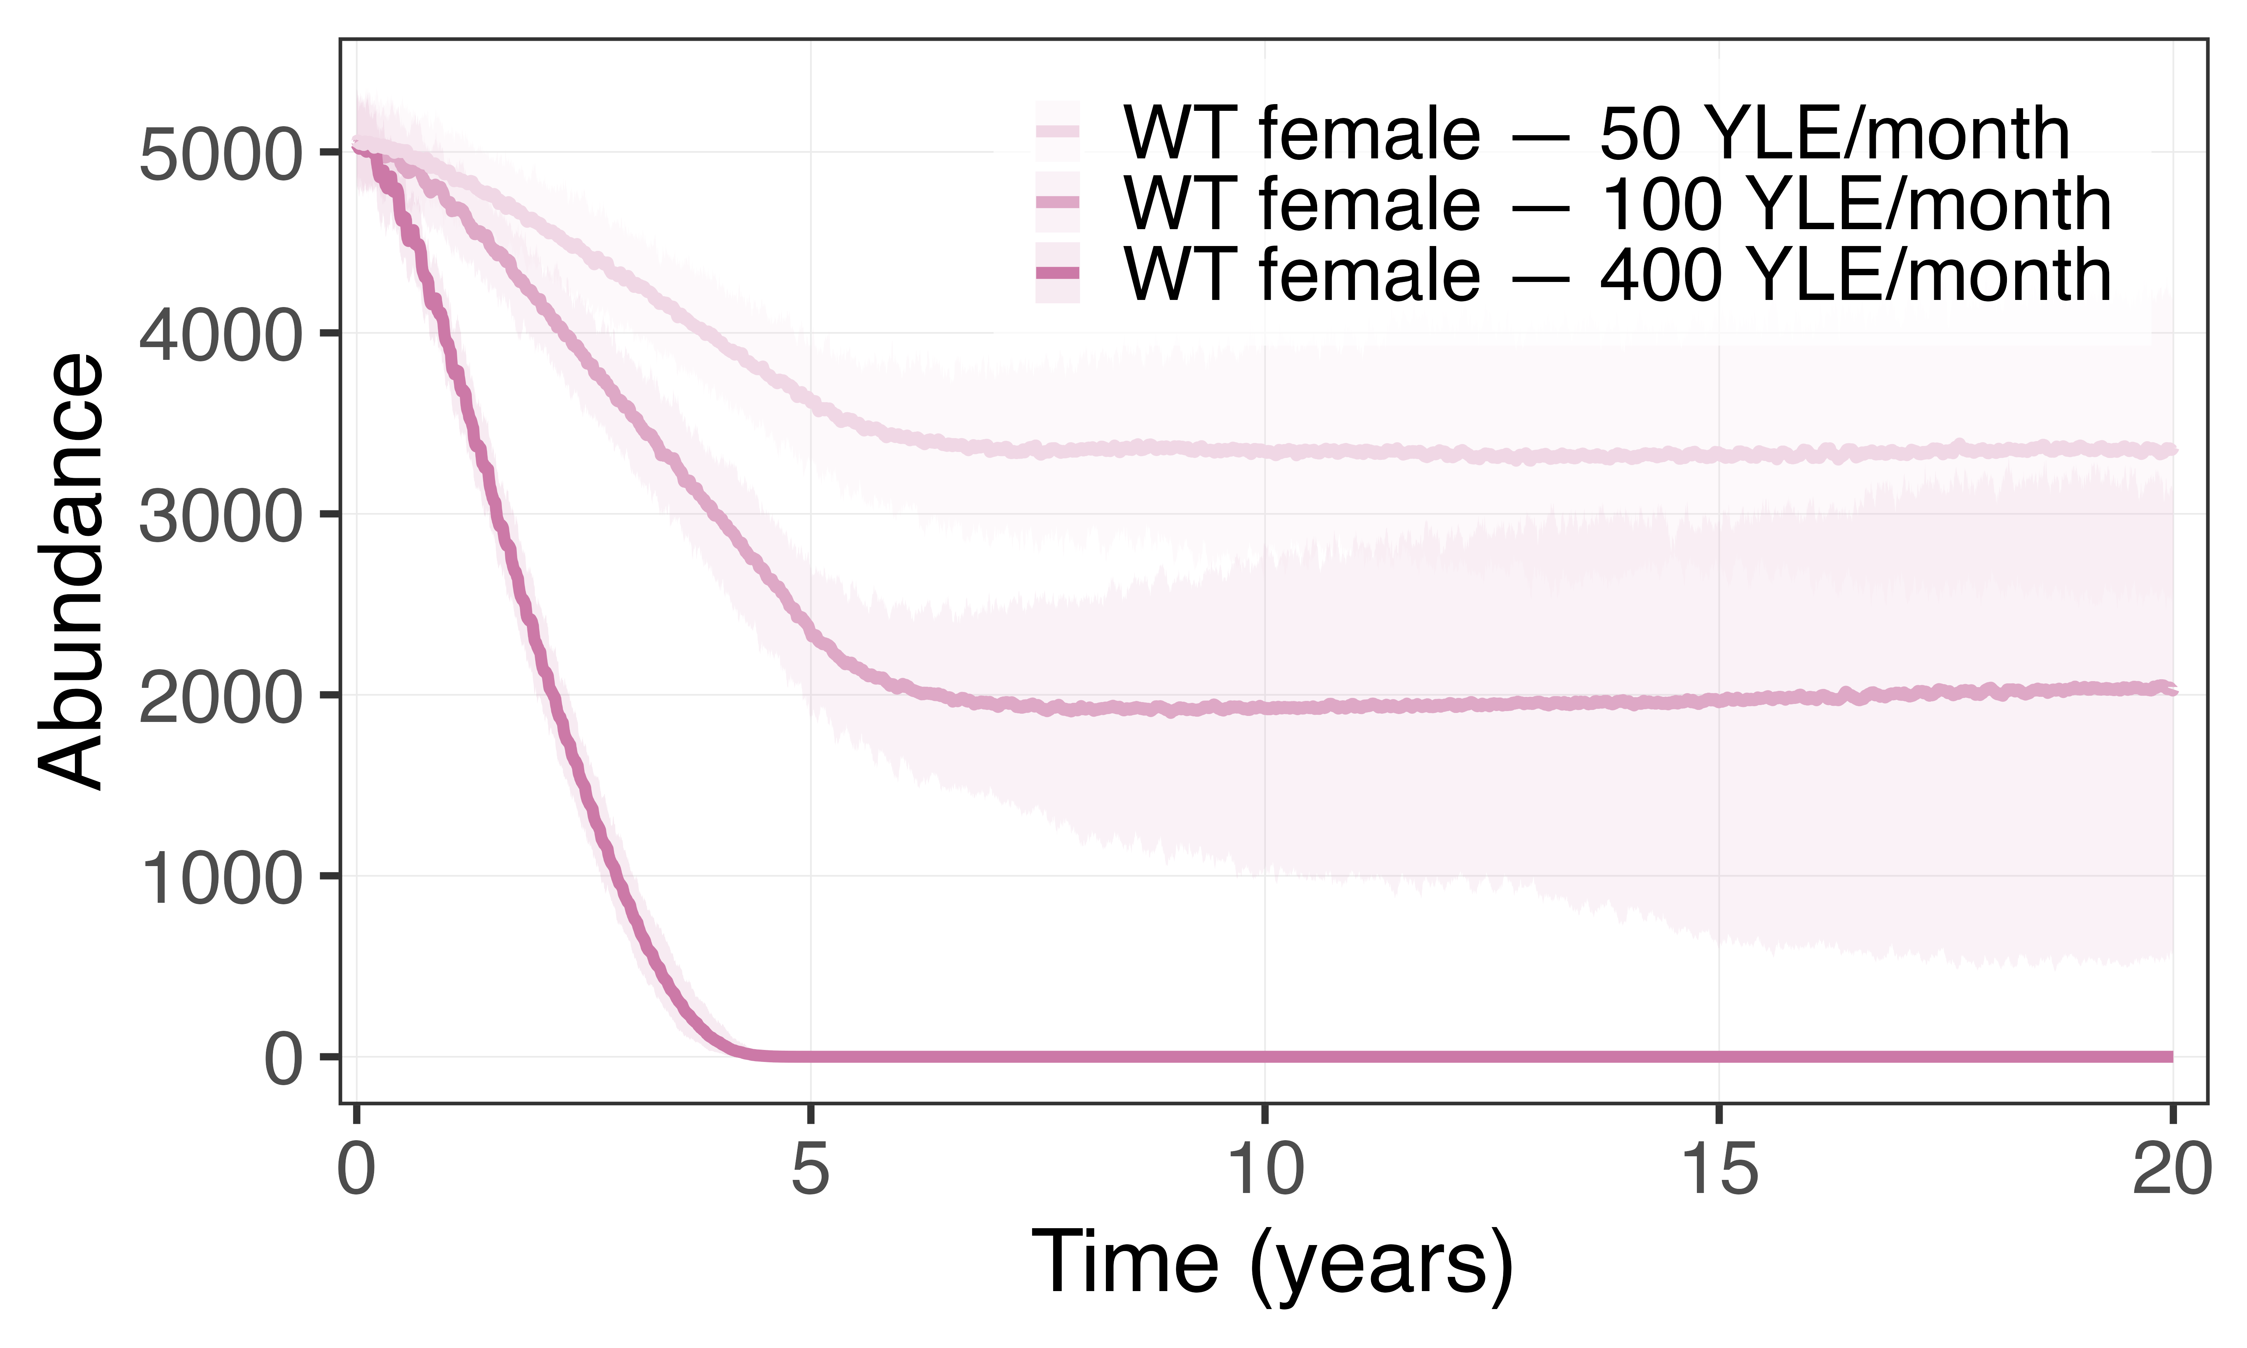

a
b
YLE Male
WT Female
Edited Female (Non-viable/sterile)
c
Y-Linked Editor
Female specific
Dominant mutation

